Slide 1
Sprint review
Group 37

Slide 2
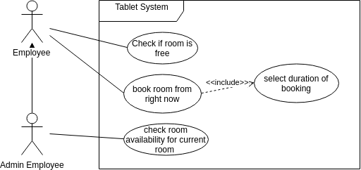
Use case diagrams

Slide 3
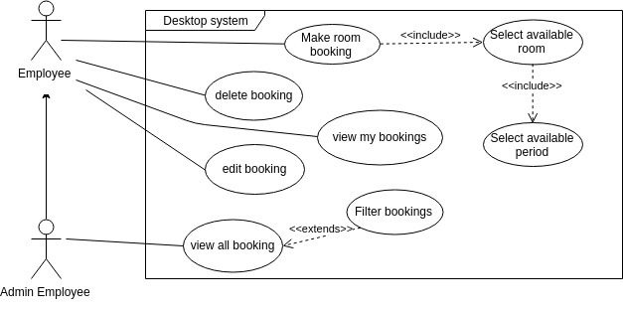
Use case diagrams

Slide 4
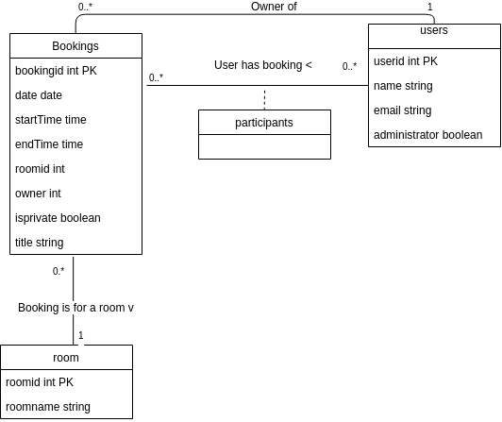
Class diagram

Slide 5
Current must have requirements
This sprint:
See who booked a room unless the meeting is set to private
Setting meeting to private
See an overview of all bookings for one room for a whole week from desktop
See an overview of which rooms are currently free on desktop
Make booking for every available room from the desktop interface (far in future) with e-mail and such
Last sprint:
See a list of todays bookings of a specific room on a tablet
Be able to create a booking for a specific room on the tablet if the room is free
Next sprint (back-end is already done for all these):
Update+cancel your own bookings
Admin: Update+cancel everyone's bookings

Slide 6
Current nice to have requirements
This sprint:
Add e-mail/name (with autocomplete) on tablet to booking
Show alternative rooms at the tablet of an already booked room
Next sprints:
Making front-end beautiful
Recurring bookings
E-mail reminders
Full Google calendar integration
Google account authentication
Add more participants outside of booking owner (done on back-end)

Slide 7
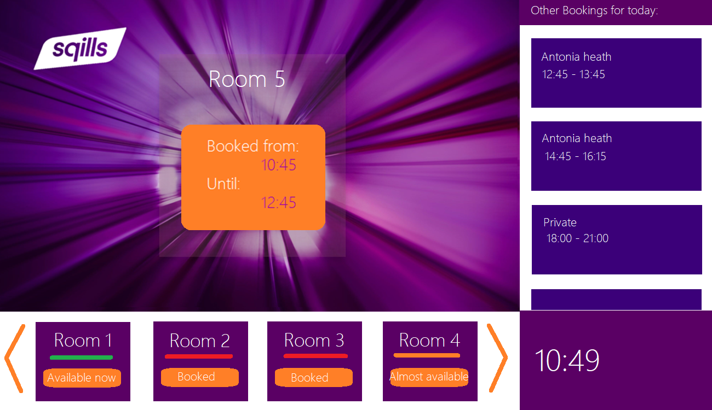
Mock-up

Slide 8
Demo time!

